Slide 1
Measures of Performance Response Time or Execution Time
The time between the start and completion of a task.
The total time required for the computer to complete a task, including disk accesses, memory accesses, I/O activities, operating system overhead, CPU execution time, and so on.
A Personal Computer User is interested in reducing the Response Time.

Slide 2

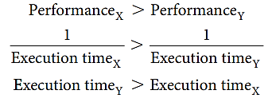
Performance
To maximize performance, we want to minimize response time or execution time for some task.
This means that for two computers X and Y, if the performance of X is greater than the performance of Y, we have:
That is, the execution time on Y is longer than that on X, if X is faster than Y.

Slide 3


Relative Performance
“X is n times faster than Y”—or equivalently “X is n times as fast as Y”— means
If X is n times as fast as Y, then the execution time on Y is n times as long as it is on X:

Slide 4


CPU Execution Time for a Program
Clock Cycle Time = 1 / Clock Rate
Notes:
Th is formula makes it clear that the hardware designer can improve performance by reducing the number of clock cycles required for a program or the length of the clock cycle. As we will see in later chapters, the designer oft en faces a trade-off between the number of clock cycles needed for a program and the length of each cycle. Many techniques that decrease the number of clock cycles may also increase the clock cycle time.

Slide 5
Instruction Performance
Since different instructions may take different amounts of time depending on what they do, CPI is an average of all the instructions executed in the program.

Slide 6
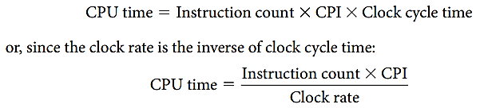
The Classic CPU Performance Equation
Instruction count: The number of instructions executed by the program.
CPI: Average Clock Cycles per Instruction

Slide 7
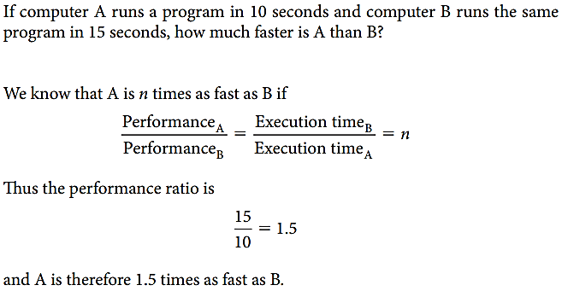
Relative Performance Example-1

Slide 8
Improving Performance Example-2 (Contd.)
Our favorite program runs in 10 seconds on computer A, which has a 2 GHz clock. We are trying to help a computer designer build a computer, B, which will run this program in 6 seconds. The designer has determined that a substantial increase in the clock rate is possible, but this increase will affect the rest of the CPU design, causing computer B to require 1.2 times as many clock cycles as computer A for this program. What clock rate should we tell the designer to target?
Notes:
Page 34

Slide 9
CPU Execution Time for a Program
Clock Cycle Time = 1 / Clock Rate
Notes:
Th is formula makes it clear that the hardware designer can improve performance by reducing the number of clock cycles required for a program or the length of the clock cycle. As we will see in later chapters, the designer oft en faces a trade-off between the number of clock cycles needed for a program and the length of each cycle. Many techniques that decrease the number of clock cycles may also increase the clock cycle time.

Slide 10
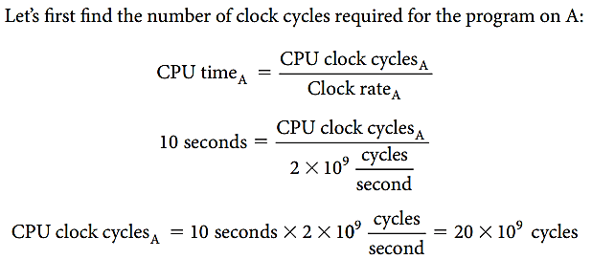
Improving Performance Example-2 (Contd.)
Notes:
Page 34

Slide 11
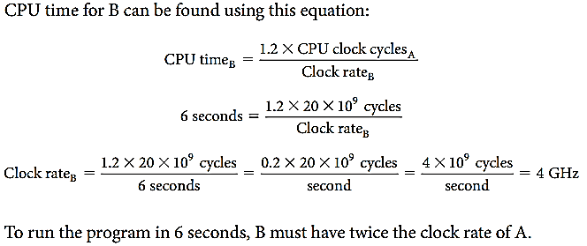
Improving Performance Example-2 (Contd.)
Notes:
Page 34

Slide 12
Using the Performance Equation Example-3 (Contd.)
Suppose we have two implementations of the same instruction set architecture. Computer A has a clock cycle time of 250 ps and a CPI of 2.0 for some program, and computer B has a clock cycle time of 500 ps and a CPI of 1.2 for the same program. Which computer is faster for this program and by how much?

Slide 13
CPU Execution Time for a Program
Notes:
Th is formula makes it clear that the hardware designer can improve performance by reducing the number of clock cycles required for a program or the length of the clock cycle. As we will see in later chapters, the designer oft en faces a trade-off between the number of clock cycles needed for a program and the length of each cycle. Many techniques that decrease the number of clock cycles may also increase the clock cycle time.

Slide 14
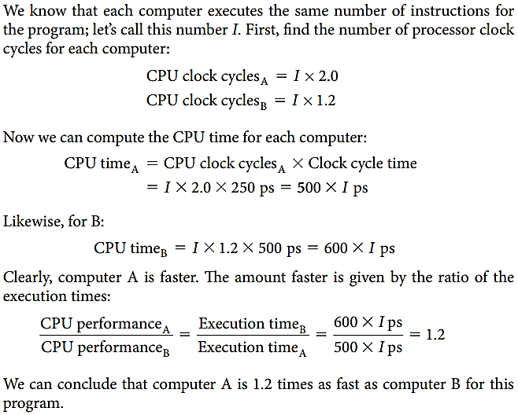
Using the Performance Equation Example-3 (Contd.)

Slide 15
The Classic CPU Performance Equation
Instruction count: The number of instructions executed by the program.

Slide 16
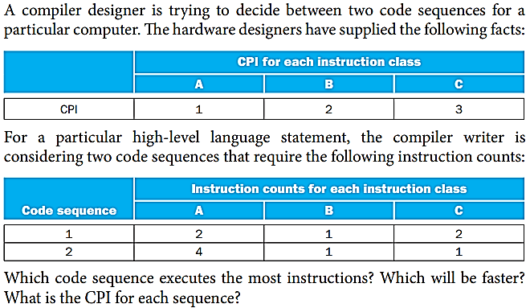
Comparing Code Segments Example-4 (Contd.)

Slide 17
Comparing Code Segments Example-4 (Contd.)
i) Which code sequence executes the most instructions?
Answer:
Sequence 1 executes 2 + 1 + 2 = 5 instructions.
Sequence 2 executes 4 + 1 + 1 = 6 instructions.
Therefore, sequence 1 executes fewer instructions.

Slide 18
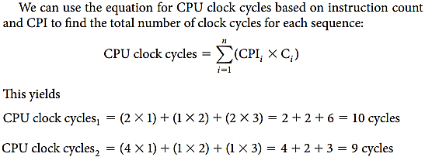
Comparing Code Segments Example-4 (Contd.)
ii) Which will be faster?
So code sequence 2 is faster, even though it executes one extra instruction.

Slide 19
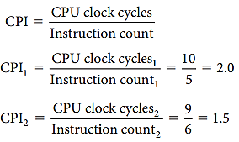
Comparing Code Segments Example-4 (Contd.)
iii) What is the CPI for each sequence?
Since code sequence 2 takes fewer overall clock cycles but has more instructions, it must have a lower CPI. The CPI values can be computed by

Slide 20
Program Execution Time

Slide 21
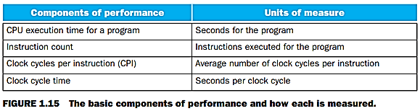
Units of Measurement

